Slide 1
HTML and CSS
Building Responsive Webpages

Slide 2
Objectives
Build one site for all devices.
Utilize responsive web design.
Understand and implement media queries.
Define a media query and its associated rules in style sheets.
Use the viewport meta element.
Evolve a layout from base styles for all devices.
Build a page that adapts using media queries.

Slide 3
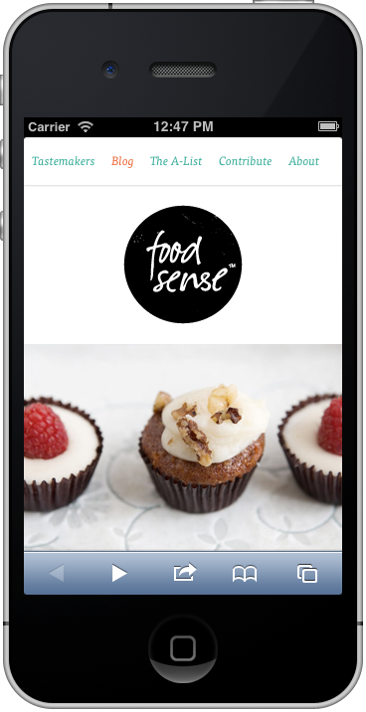
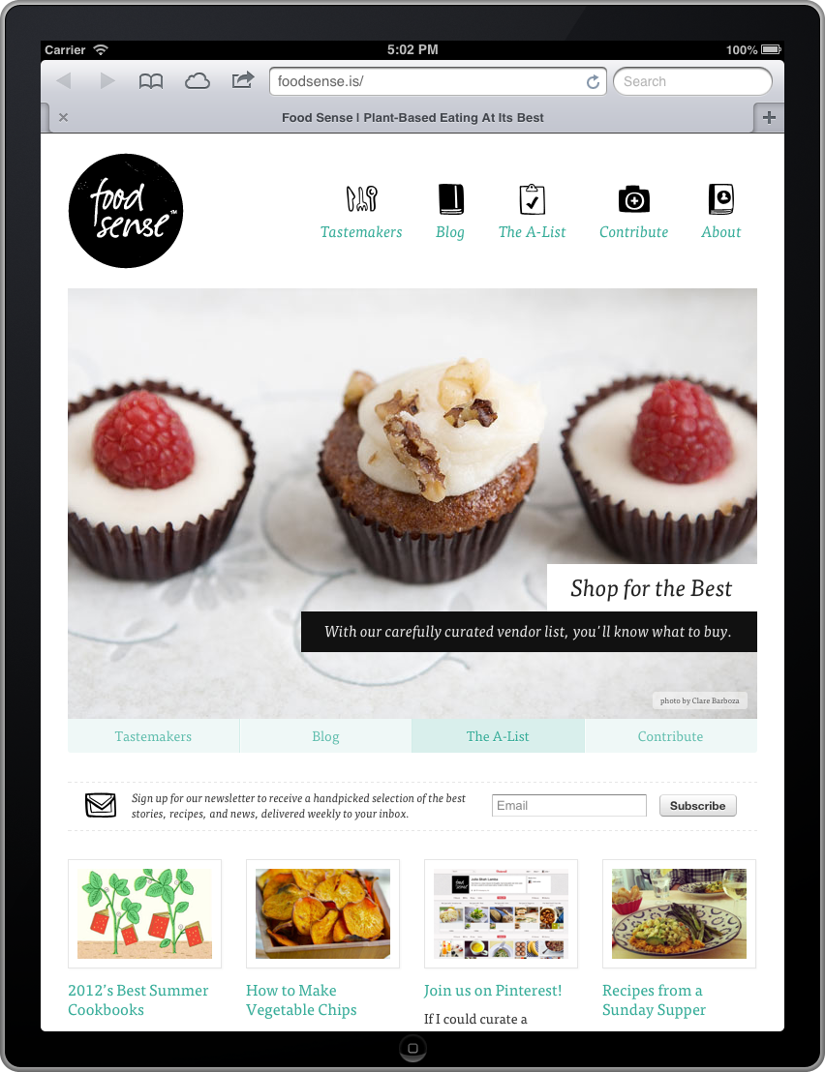
Building Responsive Webpages

Slide 4
Responsive Web Design: An Overview
We can build a single site that will work on a variety of devices now and in the future.
Components of a responsive page:
  Flexible images and media. Assets are sized with percentages so that they scale up and down in the space available to them.
  A flexible (fluid), grid-based layout.
  Media queries. Add these to your style sheet to adjust your page design based on the width of the browser’s viewable page area and other characteristics.
Notes:
Tips
John Allsopp’s article “A Dao of Web Design” (http://alistapart.com/article/dao), written all the way back in 2000, made the argument for designing and building flexible websites. It was a precursor to responsive web design, and Marcotte and many others have cited it as a big influence. It’s well worth a read.
Jeremy Keith summed up the value in building one site for all devices in his “One Web” presentation (www.vimeo.com/27484362/). The transcript is available at www.adactio.com/articles/4938/.

Slide 5
Foodsense Homepage
Smartphone browser
iPad browser

Slide 6
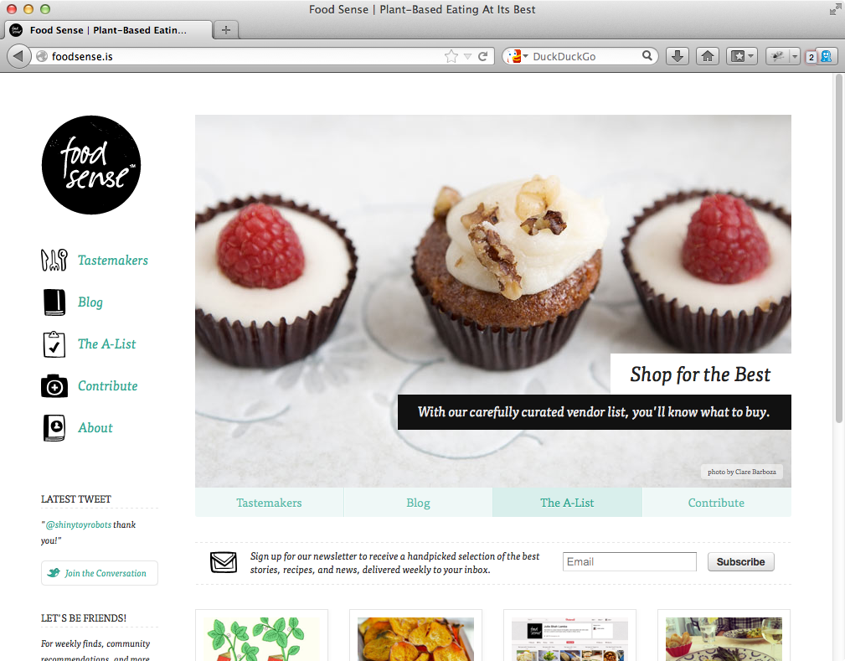
Foodsense Homepage in Desktop Browser

Slide 7
Making Images Flexible
Flexible images scale up or down in the available space but never get wider than their normal width.
  Available space is determined by the element that contains the image.
To make your images flexible:
  For each image you wish to make flexible, omit the width and height attributes from the img tag in your HTML.
  In your style sheet, apply max-width: 100%; to each image you want to be flexible.
Notes:
Tips
Specifically, the space an image fits within is the containing block established by its parent. If the parent has horizontal padding, the available space would be reduced. See “Setting the Height or Width for an Element” in Chapter 11 for a refresher on the containing block.
Be sure to use max-width: 100% and not width: 100%;. They both scale an image within its container. However, width: 100%; tells the image to be as wide as its containing element at all costs. If that element is wider than the image, the image will scale up beyond its normal size, possibly making it look a little fuzzier than you’d like.
Icon fonts and SVG allow you to include graphics that scale up and down with no loss in fidelity. See “Where to Find Web Fonts” in Chapter 13 and “Scaling Images with an Image Editor” in Chapter 5, respectively.
Don’t forget to optimize your images so their file sizes are as small as possible. See “Saving Your Images” in Chapter 5.
This technique also works for images you’ve made twice as large for the benefit of Retina displays. Of course, double-resolution images can have much larger file sizes too. See “Scaling Images with the Browser” in Chapter 5 regarding preparing images for Retina displays, including a tip that could help you reduce the file sizes quite a bit.
Except in IE8, you can make background images scale with the background-size property. See www.css3.info/preview/background-size/ for more information.
You also can make HTML5 video and other media flexible with video, embed, object { max-width: 100%; } (and by not including width and height for them in the HTML). Jonathan Nicol’s article may help in cases where videos don’t scale as expected (http://f6design.com/journal/2011/10/18/responsive-elements-that-retain-their-aspect-ratio/).

Slide 8
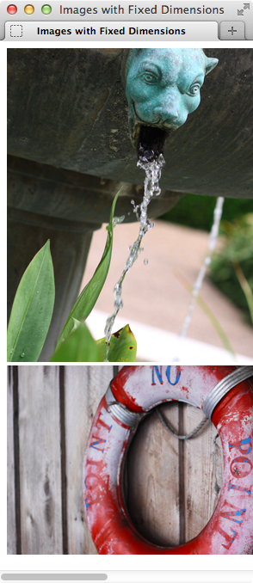
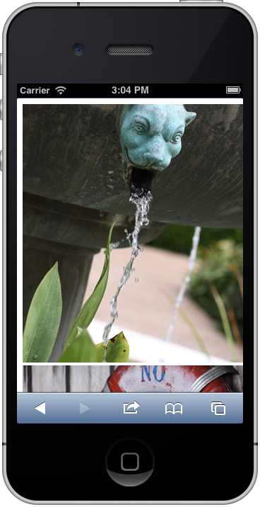
Fixed Width and Height Values

Slide 9
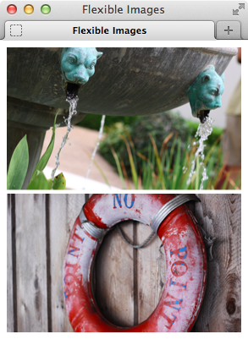
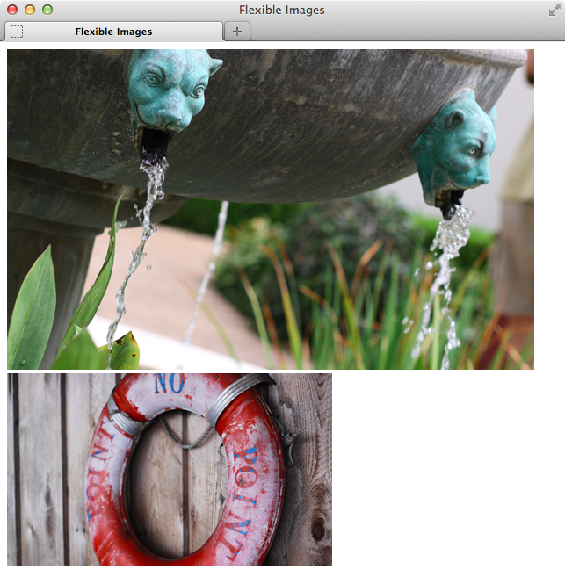
Flexible Images Scale to Fit the Element that Contains Them

Slide 10
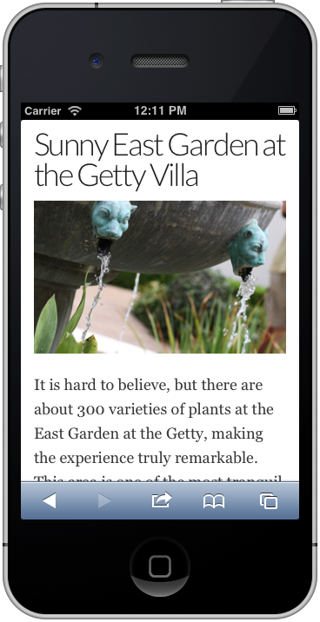
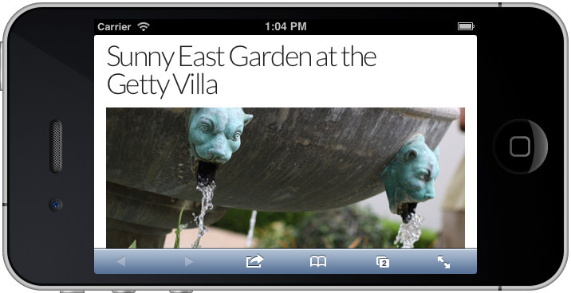
Responsive Page at 320 Pixels Wide and 480 Pixels Wide

Slide 11
Creating a Flexible Layout Grid
Flexible layouts use percentage-based widths, applying them to the main sections of the page.
When combined with flexible images, a flexible grid allows a whole page to expand and contract.
Use this formula to determine the value for the percentage:
  desired width in pixels / containing block width in pixels = value

Slide 12
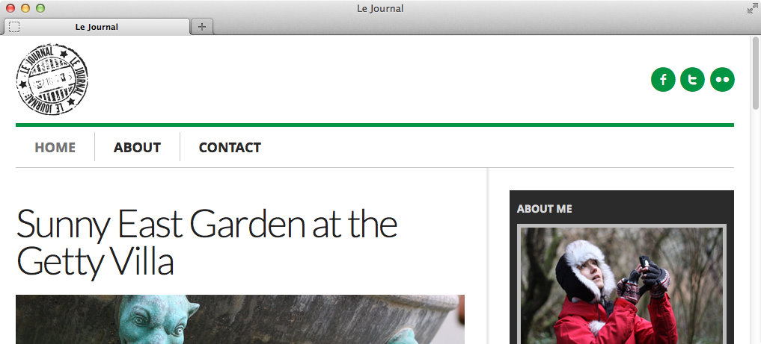
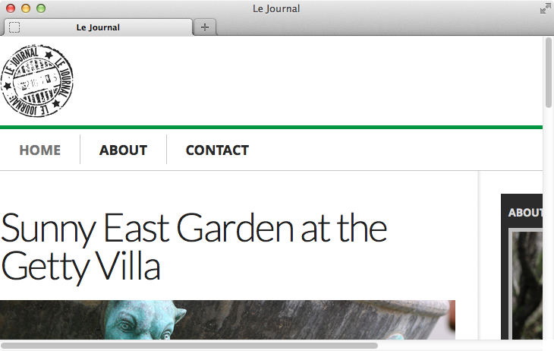
Width Remains the Same Even When the Browser is Narrower

Slide 13
To Make Your Layout Flexible
For elements requiring a width to achieve your desired layout, set width: percentage;
  percentage represents the percentage of horizontal space you want the element to occupy within its containing block.
Optionally, apply max-width: value; to the element that contains your whole page.
  value represents the maximum width to which your page can grow.
To set relative max-width, type:
  .page { max-width: 60em; }
Notes:
Tips
If the parent has horizontal padding, it establishes a smaller containing block for its children. See “Setting the Height or Width for an Element” in Chapter 11 for a refresher on the containing block.
You may also apply percentage-based horizontal margin and padding values to an element. I use ems for these properties in the sample page, which is pretty common. Padding and margins set in ems are relative to the element’s font-size while percentage-based values are relative to the element’s containing block.
One neat advantage to using ems for font-size, margin, padding, and max-width with body { font-size: 100%; } is the page scales up and down in proportion if the user changes the browser’s default font size. For example, in Firefox, you can change the default font size in the Content tab of Preferences. Give it a try while viewing www.htmlcssvqs.com/8ed/examples/12/finished-page.html!
Don’t forget that when you use the formula to calculate a percentage width for an element, its containing block comes from its immediate ancestor (that is the context).
Setting the box-sizing property to border-box allows you to define percentage widths on elements that have horizontal padding in ems or another unit without having to do complicated math to get the percentages right. This is very handy for responsive pages. See “The Box Model” in Chapter 11 for more information.

Slide 14
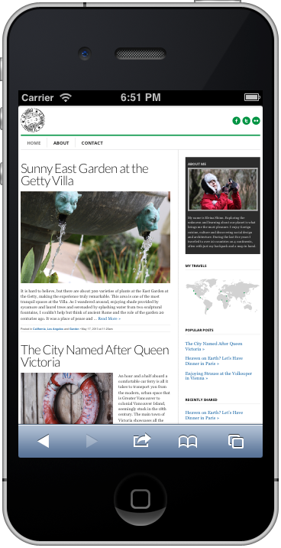
Relative Widths Page on iPhone

Slide 15
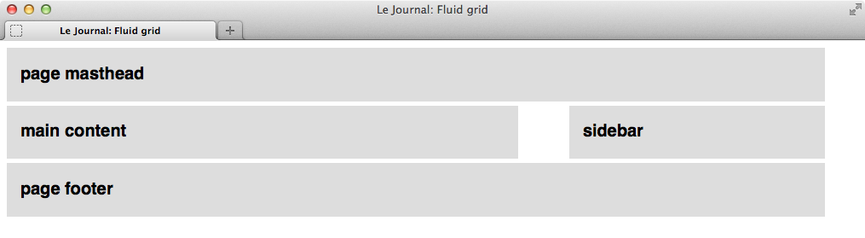
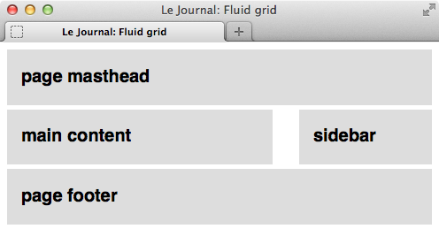
Relative Widths

Slide 16
Understanding and Implementing Media Queries
Media queries enhance media type methods, allowing styles to target specific device features.
  Adapts site’s presentation to different screen sizes.
  Media features you can include in media queries:
    width, height, device-width, device-height, orientation, aspect-ratio, device-aspect-ratio, color, color-index, monochrome, resolution, scan, grid
  Non-standard media features:
    -webkit-device-pixel-ratio
    -moz-device-pixel-ratio

Slide 17
Media Query Syntax
Basic syntax for media queries.
  For a link to an external style sheet:
    <link rel="stylesheet" media="logic type and (feature: value)" href="your-stylesheet.css" />
  For a media query within a style sheet:
    @media logic type and (feature: value) {
    /* your targeted CSS rules go here */
    }

Slide 18
Media Query Syntax Components
Syntax components:
  Logic portion: Optional value of either “only” or “not.”
    “Only” ensures older browsers don't try to read rest of media query, ignoring the linked style sheet altogether.
    “Not” negates result of media query, making opposite true.
  Type portion: Media type, such as screen or print.
  Feature: value pair: Optional. If present, must be inside parentheses and preceded by “and.”
    feature is one of predefined media features, like min-width, max-width, and orientation.
    value is optional for color, color-index, and monochrome features.

Slide 19
Media Query Lists
Separate each media query with a comma to chain together sets of features and values and create a list of media queries.
A whole media query list is true if any one of the media queries in the comma-separated list is true.
Media queries let you apply styles to a page based on specific media features of a device.
Although there are several features media queries can include, min-width and max-width are what you will use the most for responsive webpages.
Notes:
Tips
Any base style rules you include outside the media queries are applied to all devices. You can override those as desired with media queries. To clarify, declarations within media query rules only write over conflicting declarations in the regular styles, such as color: green. If the p rule before the media query had included font-style: italic;, paragraph text would still be italicized when the media query is true, because the p rule within the media query doesn’t specify font-style.
If you own a Mac, you can use Apple’s free iOS Simulator to test the example pages on the iPhone and iPad. See “Testing Your Pages” in Chapter 20 for more information.
Descriptions for all media features are available in the CSS3 Media Queries spec (www.w3.org/TR/css3-mediaqueries/#media1).

Slide 20
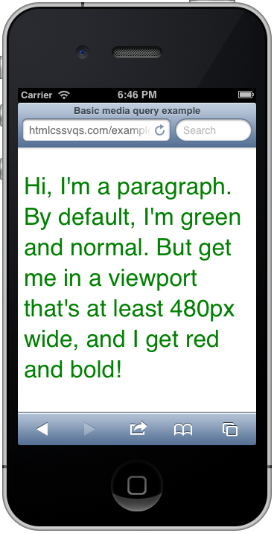
Mobile Safari’s Viewport
Mobile Safari’s viewport in portrait mode is 320 pixels wide, so the text remains green per the base styles in the style sheet.

Slide 21
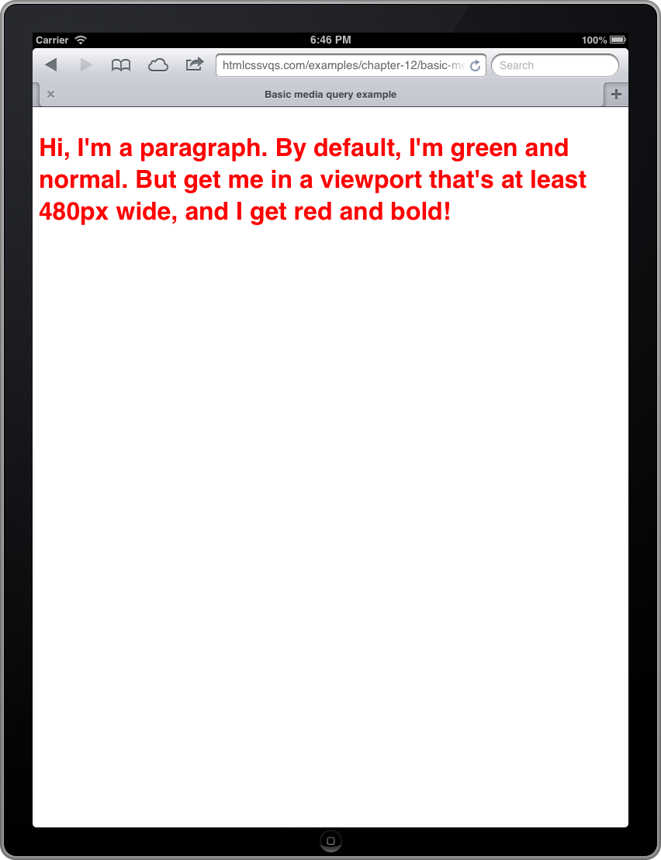
Mobile Safari’s Viewport
Text turns red and bold because the Safari browser’s viewport is 768 pixels wide in portrait view on the iPad, and the media query triggers when the width is 480 pixels or greater.

Slide 22
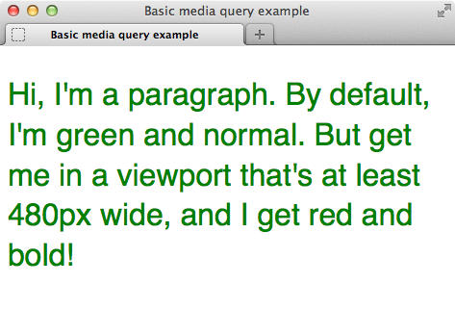
Firefox Viewport
Firefox with the lower-right corner dragged in to make the viewport narrower than 480 pixels, so the text is green with a normal font-weight.

Slide 23
The Viewport and Using the Viewport Meta Element
Viewport is the area within the browser that displays the page, both on desktop and mobile browsers.
  Doesn’t include things like browser’s address bar or buttons, just browsing area.
  Media query width feature maps to viewport width.
Values often differ by default on mobile devices.
  Page display zoomed out by default.
Add viewport meta element to head of pages.
  width=device-width code sets viewport width to same as device width.
Notes:
Tips
See “Rendering the media query styles in IE8 and below” to learn how to patch deficiencies in those versions of IE.
Any base style rules you include outside the media queries are applied to all devices. You can override those as desired with media queries. To clarify, declarations within media query rules only write over conflicting declarations in the regular styles, such as color: green; in the case of B. If the p rule before the media query had included font-style: italic;, paragraph text would still be italicized when the media query is true, because the p rule within the media query doesn’t specify font-style.
The iPhone increases a page’s zoom level when you rotate the phone to landscape mode. As a result, some content typically is out of view, requiring visitors to manually zoom back down to get the width within the boundaries of the screen. There is a way to prevent this, but at the very unfortunate cost of also preventing visitors from being able to change the page’s zoom level. However, if you must control the behavior, add the highlighted portions of this code: <meta name="viewport" content="width=device-width, initial-scale=1.0, maximum-scale=1.0, user-scalable=no" />. I advise against it, though. Instead, omit those two properties and let your visitors control zooming on your site.
You can use Apple’s free iOS Simulator to test the example pages on the iPhone and iPad. See the “Mobile Coding and Testing Tools” sidebar in the next section.

Slide 24
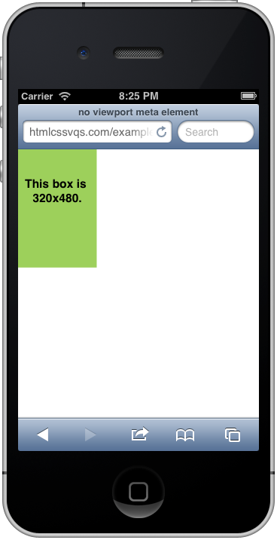
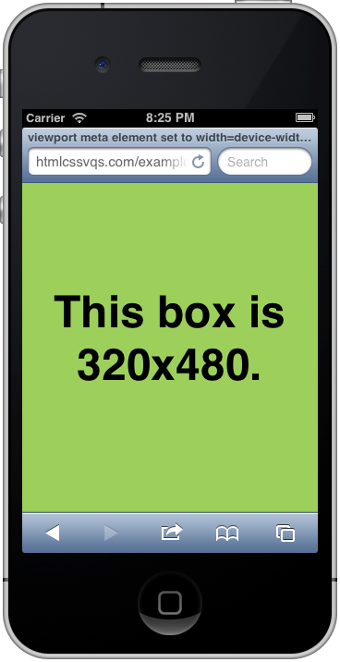
Setting Viewport Meta Element to width=device-width

Slide 25
Putting It All Together
Creating your content and HTML:
  Begin with solid, carefully considered content.
  Underlying HTML for the example page is the same, with one exception:
    Add <meta name="viewport" content="width=device-width, initial-scale=1.0" /> to the head element.

Slide 26
The Mobile-First Approach
Provide baseline styles for all devices:
  Basic styles for text (fonts, colors, sizes), padding, borders, margins, and backgrounds, and styles for making images flexible.
  Avoid floating content, or defining widths on containers.
  Content will run top to bottom according to the normal document flow.
Goal is for site to be legible and presentable in a single column.
Work up from there, using media queries to define styles for progressively larger screen sizes.

Slide 27
Evolving Your Layout: Step by Step
Evolve a layout from base styles for all devices and gradually work up to a layout suitable for a range of viewport sizes and devices:
To do so, leverage media queries to define styles for each breakpoint in your page.
  Breakpoint: Each width at which content would benefit from adjustment.
    Breakpoints depend on what is right for content, design, and audience.

Slide 28
To Build a Responsive Webpage
Create your content and HTML.
In the head element of your HTML page, type:
  <meta name="viewport" content="width=device-width" />
  or <meta name="viewport" content="width=device-width, initial-scale=1" />.
Apply your baseline styles for all devices.
  Make sure you set images to shrink and expand.

Slide 29
To Build a Responsive Webpage
Identify breakpoints for your content. Create media queries to adapt your layout for different viewport widths, moving from small-screen to large-screen.
If you need to assign widths to parts of your page, use percentages.
Choose how you would like older versions of IE to display your page. Test away!
Refine your CSS as necessary, and test until the page renders as desired across a range of devices.
Notes:
Tips
Eivind Uggedal’s http://mediaqueri.es site is an ever-expanding gallery of responsive sites in the wild. It’s worth a look for inspiration.
The Screen Sizes website (http://screensiz.es) provides screen resolution and device width information for popular devices and monitors. The information may be helpful when crafting media queries.

Slide 30
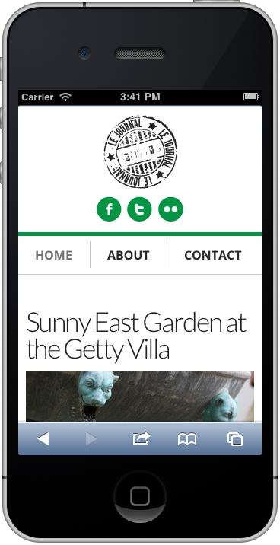
iPhone
Main navigation is on a single line, with the links separated by a gray vertical border, thanks to the media query.

Slide 31
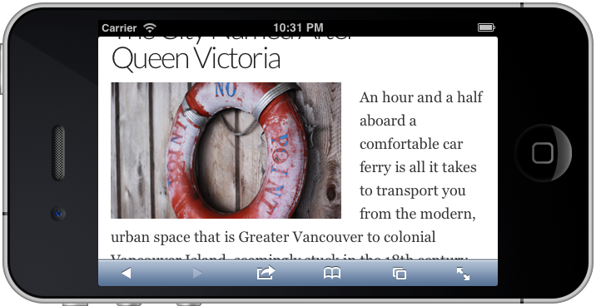
iPhone
The text wraps around the floated image.

Slide 32
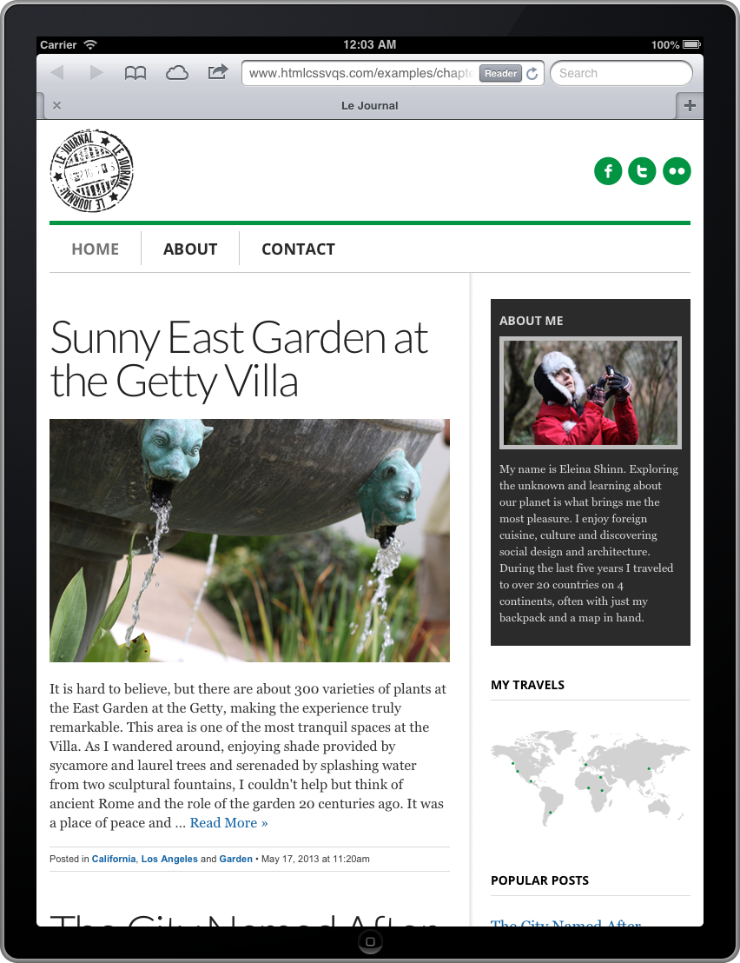
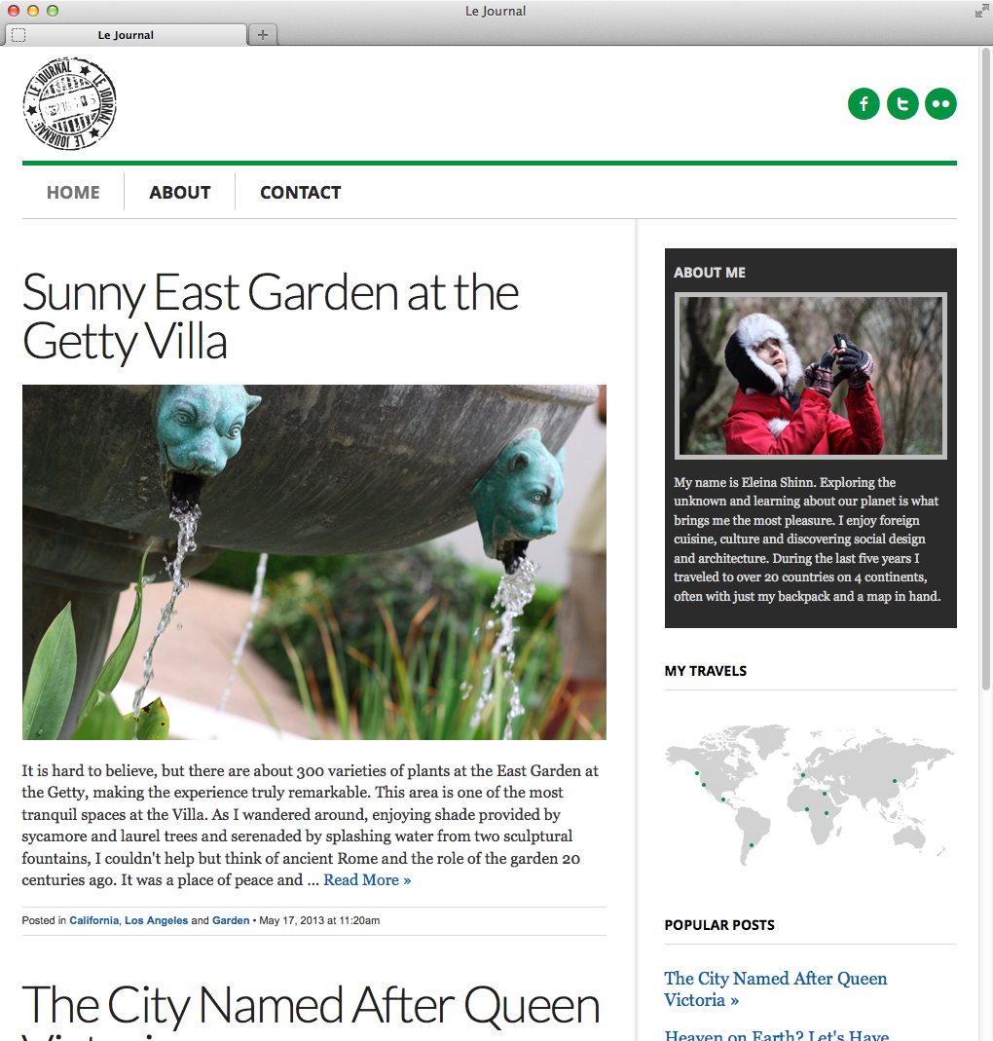
iPad and Desktop Renderings of Completed Page

Slide 33
Testing a Responsive Page
Resize desktop browser to approximate viewport size of various mobile phones and tablets.
  Be sure to resize your browser in and out to test how layout adjusts when viewed on a desktop.

